Slide 1
HOSPITAL FINDER- WEB APPLICATION
PIP104 PROFESSIONAL PRACTICE-II
VIVA-VOCE
Batch Number: 27
Roll Number 20211CAI0119 20221LCA0004 20211CAI0084 | Student Name : Nakshatra K Punith R Kaushik
Under the Supervision of,
Dr. Nihar Rajan Nayak,
Assistant Professor,
School of Computer Science Engineering,
Presidency University.

Slide 2
Introduction:
In today’s fast-paced world, the efficient management and accessibility of healthcare resources have become critical, especially during emergencies where every second counts. The EmergencyCare System addresses this need by providing a comprehensive platform for real-time hospital data management and emergency healthcare coordination. This system empowers users to search for hospitals based on proximity, specialties, and availability of critical resources such as beds, ICUs, and emergency services. By integrating advanced features such as multilingual support, emergency indicators, and dynamic updates, the platform ensures that patients and healthcare providers have seamless access to accurate information, thereby improving decision-making and reducing response times.
The system not only benefits patients but also enhances hospital operational efficiency by automating data validation, streamlining resource allocation, and enabling predictive analytics. Designed to be scalable and adaptable, it leverages modern technologies such as real-time APIs, data synchronization, and responsive design to cater to diverse user needs. With its user-friendly interface and transparent information-sharing mechanisms, the EmergencyCare System bridges gaps in healthcare accessibility, fosters trust, and aligns with global efforts toward universal health coverage and emergency preparedness. This innovative solution serves as a transformative step in addressing the challenges of healthcare delivery in both urban and rural settings.

Slide 3
Literature Review:
Real-Time Systems in Healthcare Liu and Layland explored the role of real-time systems in healthcare, highlighting their importance in ensuring timely data updates and efficient resource allocation during emergencies. They emphasized how real-time synchronization improves decision-making and patient outcomes.
Big Data Analytics in Healthcare Wang et al. discussed the integration of big data analytics in healthcare, enabling hospitals to predict resource demand, analyze patient trends, and optimize bed and staff allocation. Their work underscores the importance of data-driven solutions in modern healthcare.
Hospital Resource Management Green and Savin examined methodologies for effective resource allocation in hospitals. Their research highlights key strategies for managing beds, ICUs, and emergency resources, particularly during peak demand periods.
Hospital Rating Systems Bardach and Hibbard focused on how hospital rating systems influence patient decision-making. Transparent and accessible data empower patients to make informed choices and drive accountability among healthcare providers.
Emergency Care in Low-Resource Settings Razzak and Kellermann emphasized the challenges in providing emergency care in resource-constrained environments. Their study stressed the need for scalable systems to bridge healthcare gaps in underserved regions.
Emergency Preparedness Strategies Adini and Goldberg discussed emergency preparedness in hospitals, focusing on real-time data sharing, coordination among agencies, and resource mobilization during crises. Their work provides a framework for improving hospital readiness.

Slide 4
Research Gaps Identified:
Identifying research gaps in healthcare management system app development using Java
may involve several considerations.
Interoperability and Integration : Explore ways to enhance interoperability with other
healthcare systems and integrate seamlessly with diverse data sources.
Security and Privacy : Investigate methods to strengthen security measures and ensure
robust privacy protection, considering the sensitive nature of healthcare data.
Usability and User Experience : Evaluate and improve the user interface and overall user
experience to optimize the application for healthcare professionals and patients.
Scalability and Performance : Research scalable architectures and methods to improve the
app's performance, especially as data volumes and user numbers increase.

Slide 5
Proposed Methodology:
Centralized Database: Manage hospital details (name, address, beds, specialties, etc.)
with real-time synchronization.
Search and Filters: Enable hospital search by name, location, or specialty and
sort by proximity or ratings.
Emergency Indicators: Highlight hospitals with active emergencies using visual
badges or icons.
Multilingual Support: Offer multiple language options to serve diverse user groups.
Admin Dashboard: Allow hospital admins to add, edit, or remove records,
update statuses, and validate data consistency.
Real-Time Updates: Refresh data every 30 seconds using APIs for up-to-date information.
Statistical Insights: Display metrics like total hospitals, bed availability, and
emergency cases using visual charts.

Slide 6
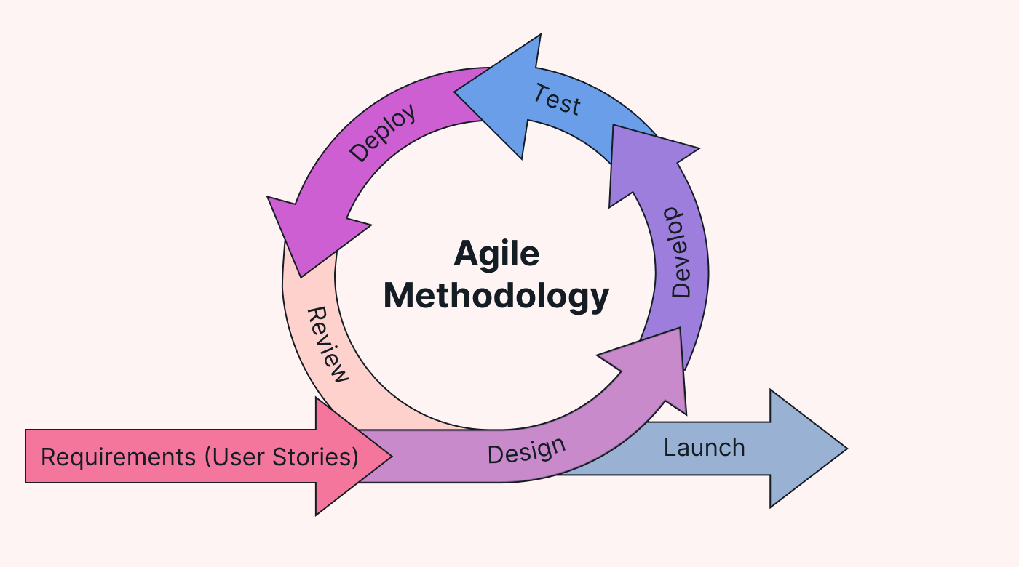
Proposed Methodology
Agile is an iterative and incremental approach to software development that emphasizes flexibility, collaboration, and customer satisfaction.
It's particularly well-suited for projects where requirements are expected to change or evolve over time.
The Agile methodology is based on the principles outlined in the Agile Manifesto and is often implemented using various frameworks such as Scrum or Kanban.

Slide 7
Objectives:
Enhanced Healthcare Access: Simplified search and filter options provide users with quick access to nearby hospitals based on their needs.
Real-Time Data Availability: Up-to-date information on hospital resources, bed availability,and emergency status ensures timely decision-making.
Improved Resource Management: Hospitals can efficiently manage and update their data ensuring operational transparency and accountability.
Multilingual Accessibility: Increased inclusivity for diverse populations through language support.
Emergency Preparedness: Highlighted emergency indicators improve response time for critical situations.
User-Friendly Interface: Intuitive design enhances usability for both patients and administrators.
Informed Decision-Making: Real-time stats and insights empower users to make better healthcare choices.

Slide 8
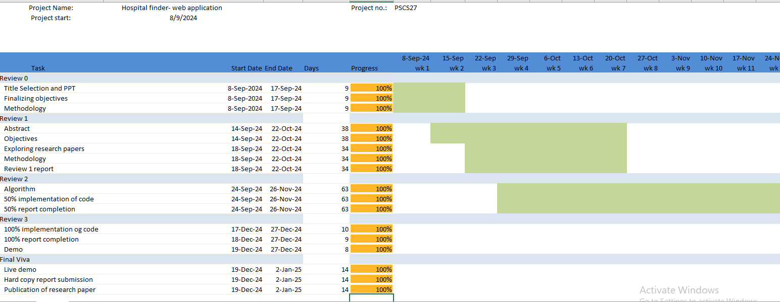
Timeline of Project:

Slide 9
Conclusion:
The proposed EmergencyCare System-Hospital Finder Application addresses critical challenges in hospital resource management and emergency healthcare delivery. By leveraging real-time data synchronization, intuitive search and filter options, and multilingual support, the platform ensures seamless access to hospital information for users and healthcare providers alike. The inclusion of features such as emergency indicators, statistical insights, and a user-friendly admin dashboard empowers stakeholders to make informed decisions and respond effectively to critical scenarios. This system bridges the gap between patients and healthcare facilities, ensuring transparency, accountability, and inclusivity.
Furthermore, the platform’s real-time updates and automated processes streamline hospital operations and optimize resource utilization. By catering to diverse populations and improving accessibility through technology, the EmergencyCare System aligns with global efforts toward universal health coverage and emergency preparedness. It provides a scalable, reliable, and comprehensive solution to modern healthcare challenges, contributing to better patient outcomes and enhanced efficiency in healthcare services.

Slide 10
References:
J. Liu and J. Layland, “Real-Time Systems and Applications in Healthcare,” IEEE Trans. Healthc. Inform., vol. 12, no. 4, pp. 233–245, Dec. 2019.
Y. Wang, L. Kung, and T. Byrd, “Big Data in Healthcare: Challenges and Opportunities,” J. Med. Internet Res., vol. 21, no. 1, pp. 1–15, Jan. 2018.
L. V. Green and S. Savin, “Optimizing Resource Allocation in Healthcare Systems,” Oper. Res. Healthc., vol. 7, pp. 1–11, Mar. 2020.
N. S. Bardach and J. H. Hibbard, “Understanding Hospital Rating Systems and Their Impact on Patient Choices,” Health Aff., vol. 34, no. 8, pp. 1259–1267, Aug. 2019.
J. A. Razzak and A. L. Kellermann, “Strengthening Emergency Care Systems in Low-Resource Settings,” Lancet Glob. Health, vol. 3, no. 4, pp. 345–355, Apr. 2020.
F. Jiang, Y. Jiang, and H. Zhi, “Artificial Intelligence in Healthcare: Challenges and Opportunities,” Nat. Med., vol. 25, no. 1, pp. 30–40, Jan. 2019.
G. Flores and M. Abreu, “Addressing Linguistic Barriers in Healthcare Applications,” BMC Health Serv. Res., vol. 19, no. 6, pp. 1–10, Jun. 2018.
B. Adini and A. Goldberg, “Emergency Preparedness in Hospitals: Strategies and Frameworks,” Disaster Med. Public Health Prep., vol. 14, no. 2, pp. 205–215, Feb. 2021.
D. A. Norman and J. Nielsen, “Designing User-Friendly Healthcare Applications: A Guide to Better UX,” J. Healthc. Inform. Res., vol. 3, no. 3, pp. 120–136, Sep. 2020.
R. Ramakrishnan and J. Gehrke, “Real-Time Data Synchronization in Distributed Systems,” ACM Comput. Surv., vol. 45, no. 4, pp. 1–23, Dec.

Slide 11
GitHub Link:
https://github.com/Nakshatra119/hospital_finder-webapplicationn

Slide 12

Thank You

